Slide 1
Database System
Yogiek Indra Kurniawan
yogiek@ums.ac.id
Universitas Muhammadiyah Surakarta

Slide 2
Outline
Definition and database structure
Information model and knowledge in Relational
Model design in conceptual diagram/physic
Change conceptual model to physic model
Normalization data model
Data Definition Language (DDL) and Data Manipulation Language (DML)
Query
DCL(Data Control Language)

Slide 3
Refference
Ramakrishnan, Raghu, Gehrke, Johannes. 2003. Database Management Systems, Third Edition. New York: The McGraw-Hill Companies, Inc.
Reingruber, Michael C & Gregory, William W; The Data Modeling Handbook A Best-Practice Approach to Building Quality Data Models, John Wiley & Son Inc, 2001
Howe, David. 2001. Data analysis for Database Design, third Edition, Butterworth-Heineman.
Rebecca M. Riordan. 2005. Designing Effective Database System. Addison Wesley Proffesional.
Fathansyah. 2012, Basis Data, INFORMATIKA

Slide 4
Definition
The system is an arrangement (alignment) which consists of a number of functional components (with all the functions / special assignments) that are interconnected and together aim to satisfy a process / specific job
Database is a collection of various data that are interconnected with each other
The database, is a collection of information stored in the computer in a systematic way so that it can be checked using a computer program to obtain information from the database.

Slide 5
Database System
Database System is a system that consists of a collection of files that are interconnected (in a database on a computer system) and a set of programs (DBMS) that enables multiple users or other programs to access and manipulate files.

Slide 7
Database system Component’s
Hardware
Operating System
Database
Database Management System ( DBMS )
User
Application

Slide 8
Data Abstraction
Level of user in see how the data can be managed in database system
3 Levels :
Physical Level
Logic Level/Conseptual Level
View Level

Slide 9
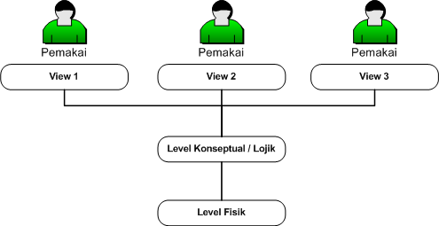

Slide 10
Language
Data Definition Language (DDL)
Data Manipulation Language (DML)
Data Control Language (DCL)

